Slide 1
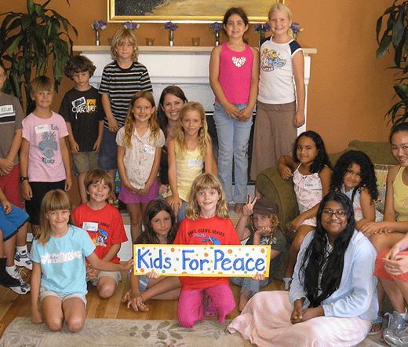
KIDS FOR PEACE PROGRAM
Notes:
Kids for peace is a program established in 2006 by two kids Jill and Danielle with the objective of providing children with peace through the use of art, social services, art and environmental services. The program also helps in management of health conditions affecting the kids.

Slide 2
HEALTH ISSUES
My program will focus on kids but especially with all kids who suffering from nervousness, because when they color and drawing they will have less stress and use all there energy on drawing and playing with other kids. Nervousness is a condition I kids affecting their proper interaction within their school and home setting. Painting allows them to remain focused and hence reducing the effects of the condition. Also, the program aims at encouraging proper eating habits among the kids.
Notes:
In most learning environments, there are kids who are affected with nervousness which prevents their proper learning and mastery of the content taught as well as their interaction. The condition also affects their concentration making them exhibit a below average performance. However, through the kids for peace program, the affected kids are able to get proper attention improving their concentration hence their performance. In addition, most kids engage in unhealthy eating habits which also promote the development of the condition due to poor self-image created. Therefore, there is need to encourage proper eating habits among the kids by ensuring they eat proper food and avoid junk and sugary foods. Through the kids for peace program, the kids are taught of the proper eating habits in an environment they properly relate with which is painting.

Slide 3
OBJECTIVES
By the end of the program the percipients will be able to identify basic colors.
By the end of the program kids should be able to develop proper eating habits.
By the end of the program the percipients will be helped reinforce concepts related to colors and all kids will be able to know attest one name of the color
Notes:
The program had well stated objectives that provide a proper assessment of the success of the program which include: by the end of the program the percipients will be able to identify basic colors. The other one being that by the end of the program the percipients will be helped reinforce concepts related to colors and all kids will be able to know attest one name of the color. Also, by the end of the program kids should be able to develop proper eating habits.

Slide 4
TARGET AUDIENCE
The program targeted kids aged from 5 to 8 years
The program identified 10 boy and 10 girl affected with nervousness.
Notes:
The color program targeted kids below the age of ten years with focus on kids between the age of 5-8 years affected with nervousness. To ensure effectiveness, 10 boys and 10 girls were identified for the program. However, through the selected group, the message of proper eating habits will be encouraged among the kids through the coloring done by the selected kids.

Slide 5
PROGRAM DESCRIPTION
The program we will offer it to the kids age from 5 to 8 which is about color and fun which give times for kids to have fun and joy.
It will be a great time to spending time drawing and coloring with kids.
The program will provide the kids with an opportunity to interact through coloring .
The kids will be able to develop proper eating habits through the program
Notes:
The kids for peace programs provides the kids with a range of opportunities for them to improve their lives including art, social services, conscious leadership and global friendship. For this program, focus will be on the use of art through coloring to improve their concentration and interaction minimizing the effects of nervousness as well as encouraging proper eating habits among the kids, allowing them to interact properly improving their performance and dietary. First, the kids will be taught on the importance of proper eating by explaining to them the adverse effects of consuming large amount sugary and junk foods. At the same time, the selected kids will be made conversant to the nervousness which affects their normal lives mostly their interaction and school work. The activity is followed by a coloring exercise involving the kids where they will express all they had learnt through coloring, allowing the kids an opportunity to interact understanding one another and providing an opportunity for improvement among the kids. the parents and the management of the kids for peace program will support to the program through educating the learners as well as moral support and encouragement to the kids. The program attained several successes which included the proper explanation of the objectives of the program allowing potential stakeholders to take part in the events of the program. However, there are areas which require more attention to ensure success of the event in the future which is to increase the number of kids involved in the program as well as making the event an annual event. The move ensures firsthand interactions and benefits of the program.

Slide 6
MARKETING
Proper marketing of the program will ensure that the affected kids attend the program hence improving their interaction and academic performance. Social media provides a proper avenue through which the message reaches many people at the same time. Also, due to the improved technology and internet services, most people are able to access the available social media platform allowing for proper marketing.
Notes:
There are many kids affected by nervousness but do not get proper attention. However, through the kids for peace program, the affected kids are able to interact productively allowing them reduce the effects of the condition through coloring. Therefore, proper marketing of the event is critical ensuring the success of the program. For this program social media will be used to market the program since majority of the population access the available social media platforms ensuring quick and rapid spread of the information. The marketing was done through the official social media platforms for the kids for peace program ensuring the authenticity of the information. The information is then shared by those who access it allowing many people to receive the same information within t short time. The marketing proved success since more people attended the event compared to the approximated number as well as the popele who benefited from the coloring by the kids.

